Slide 1
Data Structure for recursion

Slide 2
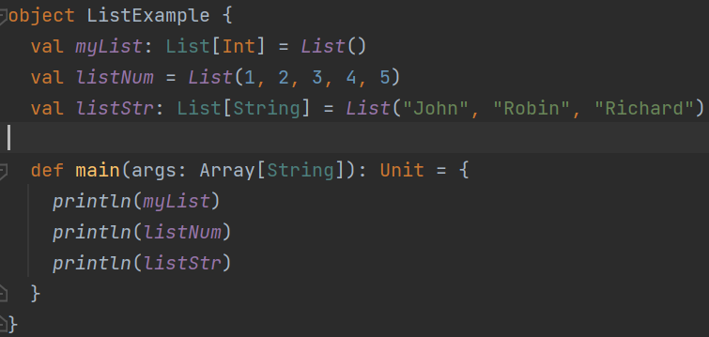
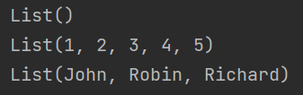
List
Immutable
Linked list
Notes:
object ListExample { val myList: List[Int] = List() val listNum = List(1, 2, 3, 4, 5) val listStr: List[String] = List("John", "Robin", "Richard") def main(args: Array[String]): Unit = { println(myList) println(listNum) println(listStr) } }

Slide 3

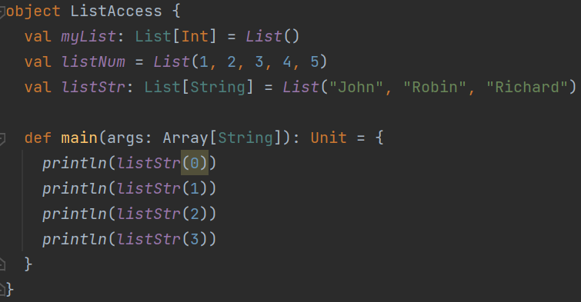
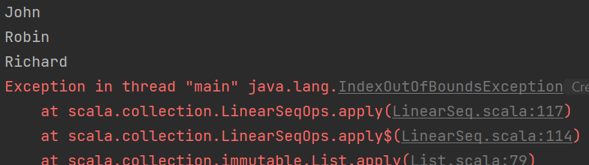



List access
Notes:
object ListAccess { val myList: List[Int] = List() val listNum = List(1, 2, 3, 4, 5) val listStr: List[String] = List("John", "Robin", "Richard") def main(args: Array[String]): Unit = { println(listStr(0)) println(listStr(1)) println(listStr(2)) println(listStr(3)) } }

Slide 4









How to define a list?
Use a cons
List of the rest of data
First data
Anything in front or between it must be a data.
Notes:
object ListAccess { val myList: List[Int] = List() val listNum = List(1, 2, 3, 4, 5) val listNum2 = List(1, 2, 3, 4, 5) val listStr: List[String] = List("John", "Robin", "Richard") def main(args: Array[String]): Unit = { val listStr2 = "Will" :: listStr println(listStr2) val listNum2 = 9 :: 6 :: 17 :: Nil println(listNum2) println(listNum ++ listNum2) } }

Slide 5




Slide 6
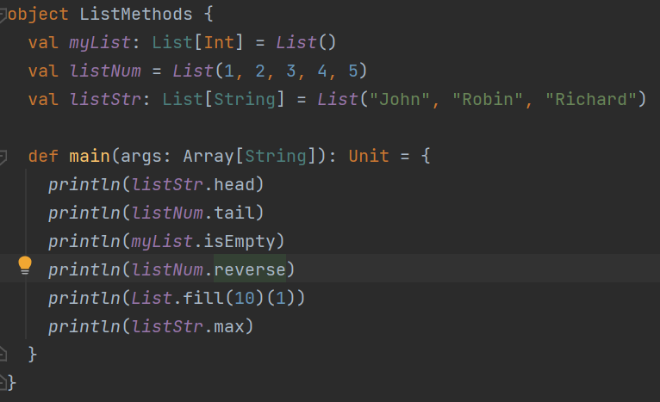
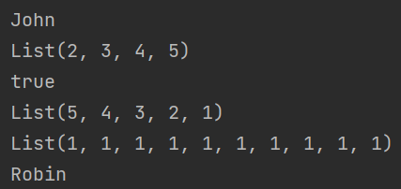
List methods
Notes:
object ListMethods { val myList: List[Int] = List() val listNum = List(1, 2, 3, 4, 5) val listStr: List[String] = List("John", "Robin", "Richard") def main(args: Array[String]): Unit = { println(listStr.head) println(listNum.tail) println(myList.isEmpty) println(listNum.reverse) println(List.fill(10)(1)) println(listStr.max) } }

Slide 7



Exercise (only isEmpty, length, head, tail, ::, ++ available)
Notes:
member 2 นาที
Sorted 2 นาที
Delete 1 นาที
length 1 นาที

Slide 8





Exercise - cont
Notes:
myReverse 3 นาที
Dot
Max
Setify

Slide 9
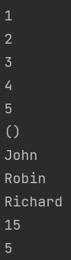
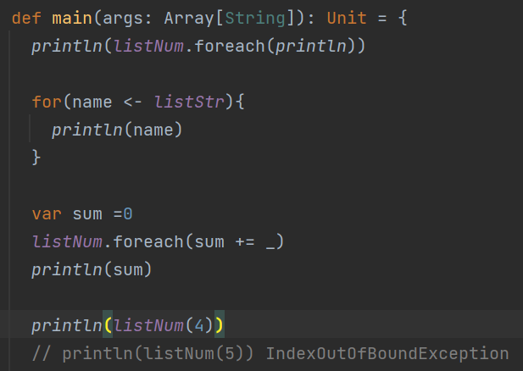
List iteration
Notes:
object ListIterate { val myList: List[Int] = List() val listNum = List(1, 2, 3, 4, 5) val listStr: List[String] = List("John", "Robin", "Richard") def main(args: Array[String]): Unit = { println(listNum.foreach(println)) for(name <- listStr){ println(name) } var sum =0 listNum.foreach(sum += _) println(sum) println(listNum(4)) // println(listNum(5)) IndexOutOfBoundException } }

Slide 10
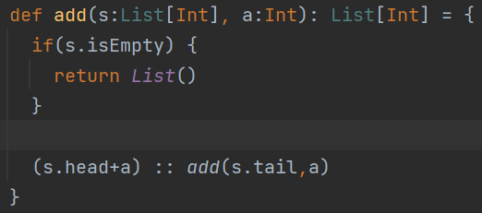


Iterate to modify a list?
Cannot be done because list is immutable.
We have to produce a new list.
Notes:
bject ListIterate { val myList: List[Int] = List() val listNum = List(1, 2, 3, 4, 5) val listStr: List[String] = List("John", "Robin", "Richard") def add(s:List[Int], a:Int): List[Int] = { if(s.isEmpty) { return List() } (s.head+a) :: add(s.tail,a) } def main(args: Array[String]): Unit = { println(listNum.foreach(println)) for(name <- listStr){ println(name) } var sum =0 listNum.foreach(sum += _) println(sum) println(listNum(4)) // println(listNum(5)) IndexOutOfBoundException println(add(listNum,10)) } }

Slide 11
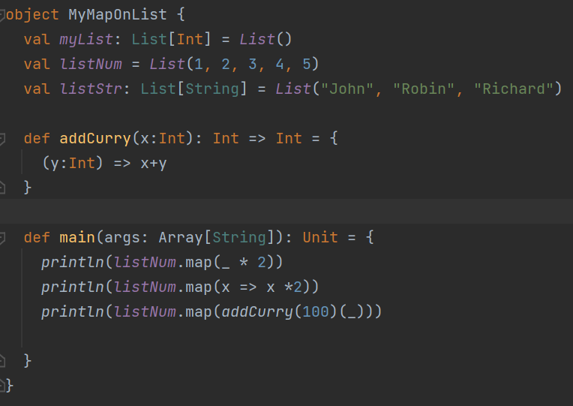
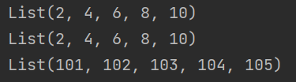
Higher order methods MAP
Notes:
object MyMapOnList { val myList: List[Int] = List() val listNum = List(1, 2, 3, 4, 5) val listStr: List[String] = List("John", "Robin", "Richard") def addCurry(x:Int): Int => Int = { (y:Int) => x+y } def main(args: Array[String]): Unit = { println(listNum.map(_ * 2)) println(listNum.map(x => x *2)) println(listNum.map(addCurry(100)(_))) } }

Slide 12
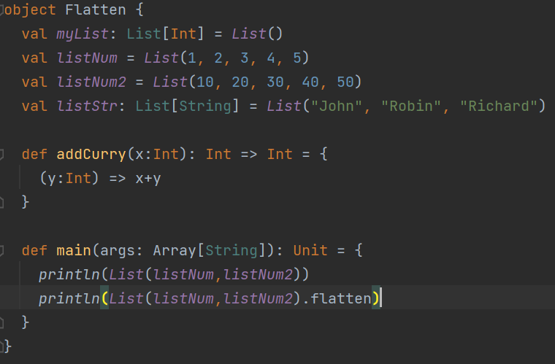

flatten
Notes:
object Flatten { val myList: List[Int] = List() val listNum = List(1, 2, 3, 4, 5) val listNum2 = List(10, 20, 30, 40, 50) val listStr: List[String] = List("John", "Robin", "Richard") def addCurry(x:Int): Int => Int = { (y:Int) => x+y } def main(args: Array[String]): Unit = { println(List(listNum,listNum2)) println(List(listNum,listNum2).flatten) } }

Slide 13
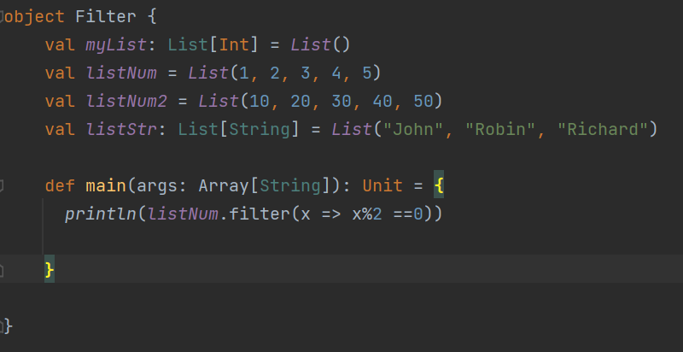

Filter
Notes:
object Filter { val myList: List[Int] = List() val listNum = List(1, 2, 3, 4, 5) val listNum2 = List(10, 20, 30, 40, 50) val listStr: List[String] = List("John", "Robin", "Richard") def main(args: Array[String]): Unit = { println(listNum.filter(x => x%2 ==0)) } }

